Slide 1

Welcome to your
Video Group Clinic

Slide 2
Hello my name is…
Your Facilitator is: Helen
Your Clinician will be either:
Laura Ireland Community Specialist
Practitioner
or
Sam Clinical Pharmacist
We currently run sessions for Type 2 Diabetes and Hypertension (high Blood Pressure)
We hope to start groups for Asthma and COPD soon

Slide 3
Identity and Location Check
To help keep you safe and get help to you if you need it, we need to do a few checks using the information you gave us and from your medical record.
If you have a friend or carer with you now, we will need to do the same checks with them too.

Slide 4
Consent and Confidentiality
Attending a Video Group Clinic (VGC) is completely voluntary. You can change from a VGC appointment to another type if you prefer.
Can we just check:
You have consented to joining the group
You approve to sharing the agreed information with the group, for example your test results.
You have reviewed your personal privacy and happy to proceed with the session
If you wish to withdraw consent or disagree with the ‘Patient Agreement’ – Tell us now!

Slide 5
Respecting each other
“All information learnt about group members is confidential. This includes us all agreeing that we will not record or share any information about other group members verbally, on social media such as Facebook, Twitter etc or in any other public forum.”
NO recording of the session including:
Sound
Video
Pictures

Slide 6
Your privacy is important to you and us
VGCs are securely encrypted. However it is your responsibility to make sure you have adequate protection, for example anti-spyware on your device to prevent un-authorised eavesdropping
Some personal information is stored locally on your device when you access a VGC. Please be aware of this especially if you are using a public or shared device
No aspect of the VGC is visually recorded. Your agreement to consent, confidentiality and medical outcomes will be recorded on your medical record

Slide 7
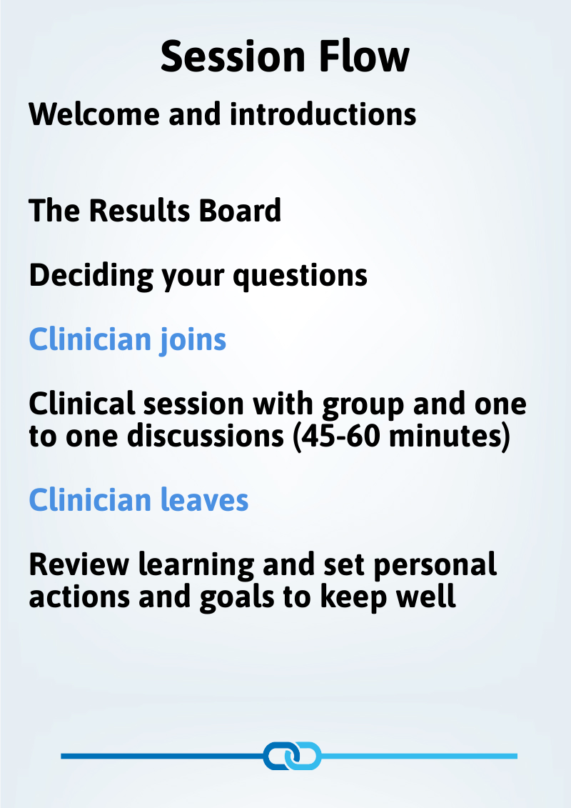
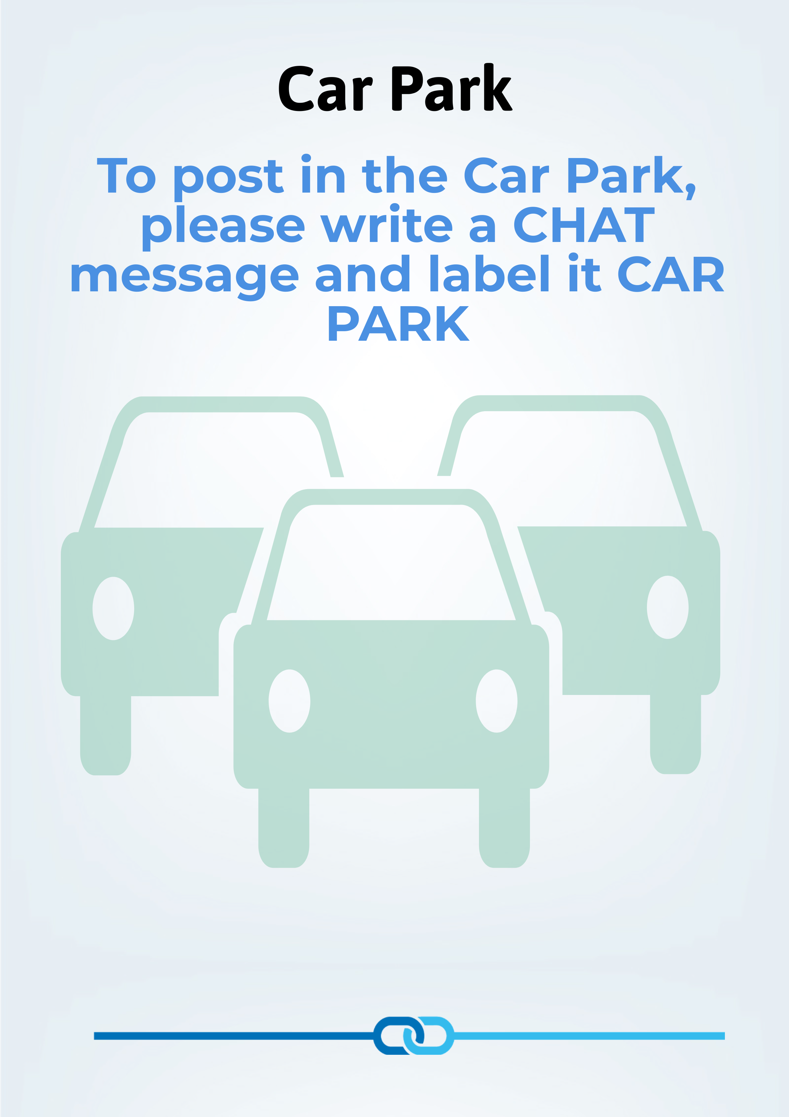
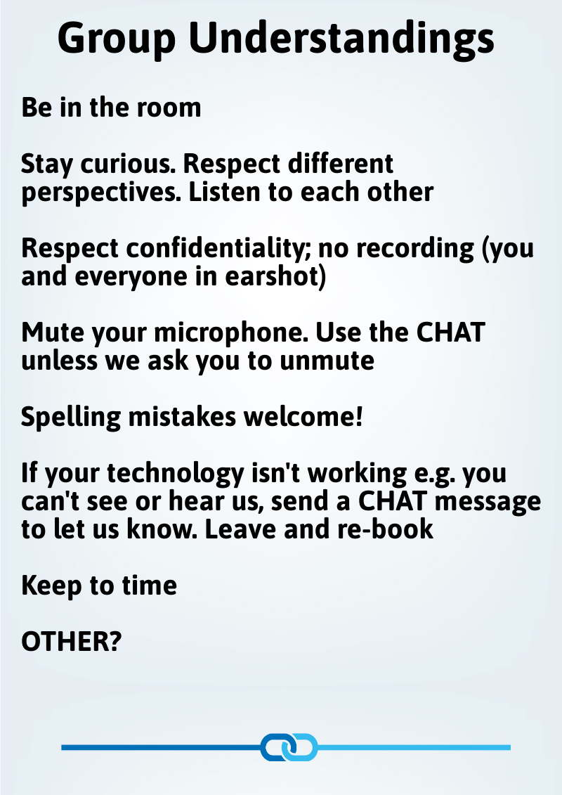

Slide 8
Our Results Board
Name | Result 1 | Result 2 | Result 3 | Result 4 | Result 5 | Result 6
First name only | HbA1c | Blood Pressure | BMI | Cholesterol | ** | **

